Slide 1
Credit Risk Project
Credit Risk Project
Intro
Title page
by Mikhail Mitrofanov, Aleksandr Egoshin

Slide 2
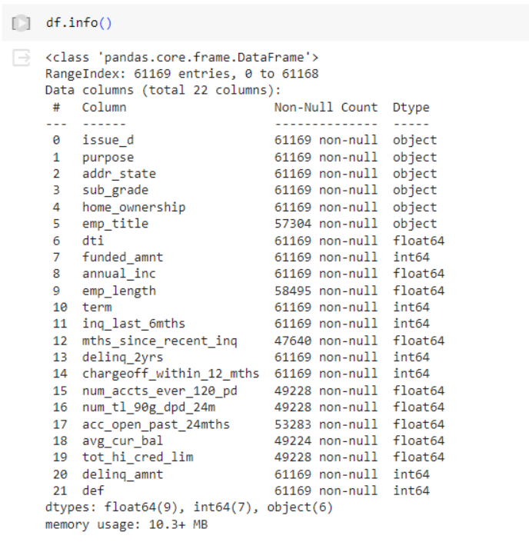
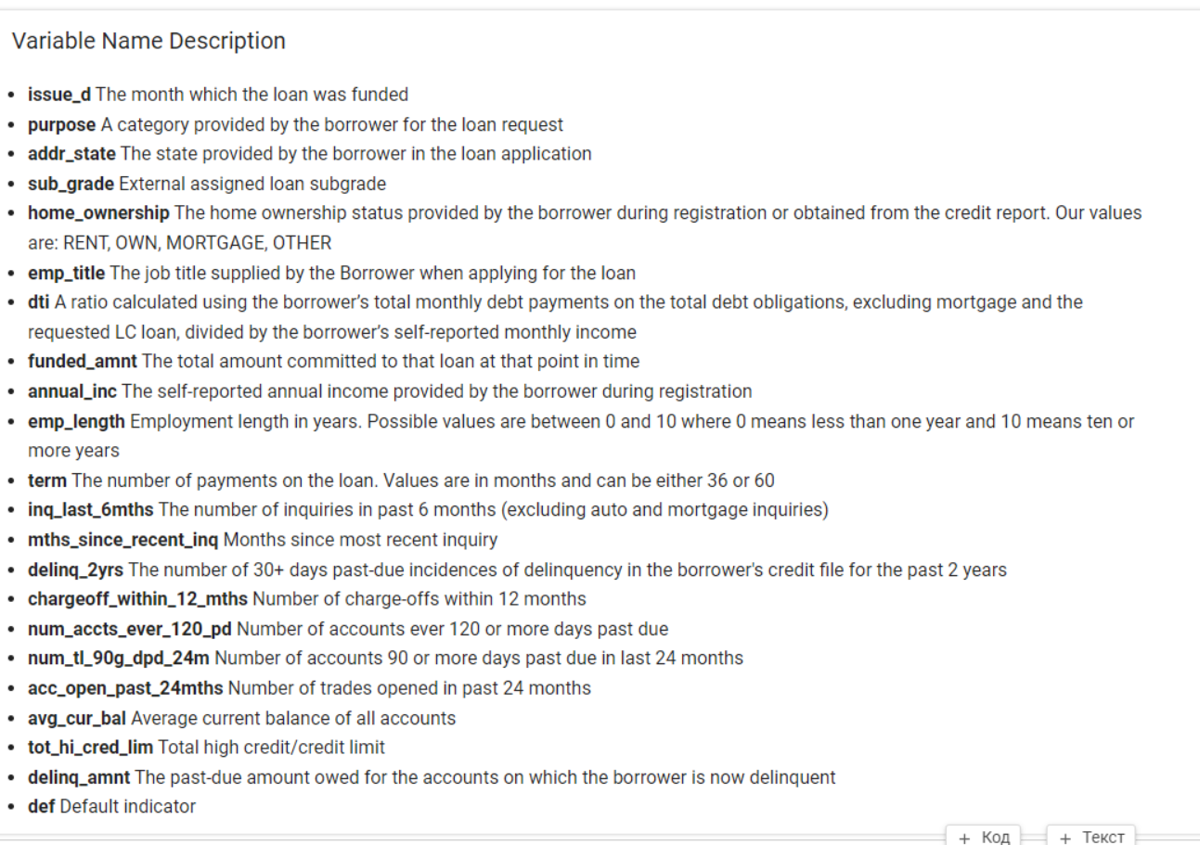
Credit Risk Project
Intro

Slide 3

Credit Risk Project
Intro

Slide 4
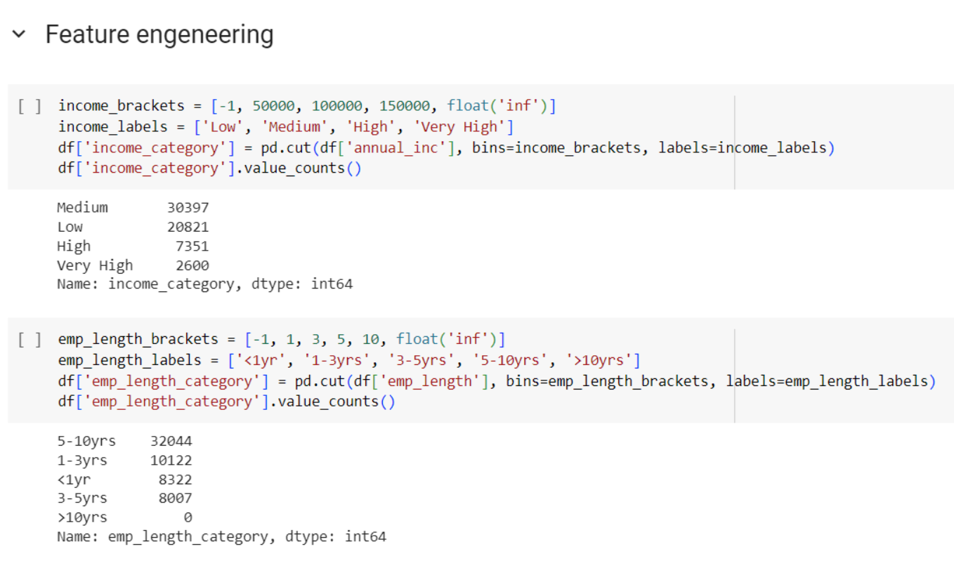
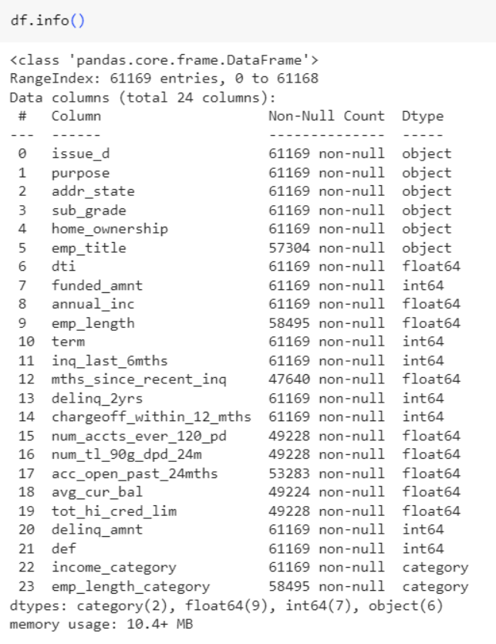
Credit Risk Project
Intro
Feature engineering

Slide 5
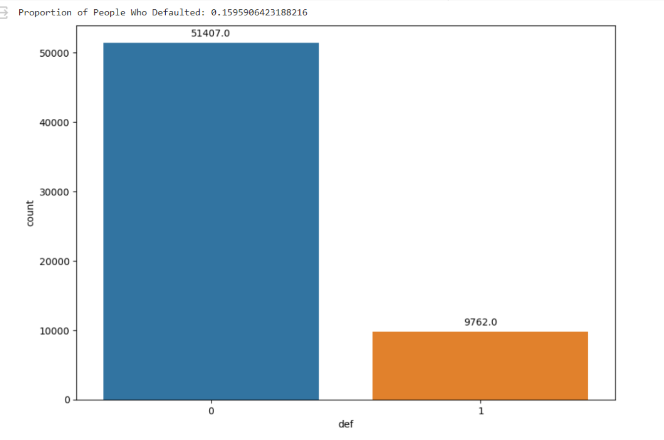
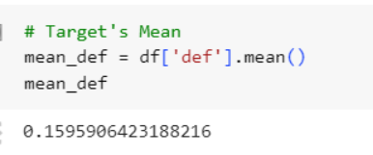
Credit Risk Project
Intro
Target Mean and Feature Selection
Feature Selection
Feature selection is deemed unnecessary, primarily because the extensive number of observations (61169) significantly surpasses the relatively modest count of features (21). This substantial difference effectively diminishes the risk of overfitting.
Furthermore, mostly, the correlation between the features is minimal, indicating an absence of redundant features. In the hypothetical scenario where redundancy exists, we could address it by either removing or reducing it through dimensionality reduction techniques.
Rule of Thumb for Feature Count:
A common rule of thumb in machine learning is the "N:10" or "N:5" rule, where "N" is the number of samples. This rule suggests having at least 10 (or 5 in some versions) times as many observations as features to reduce the risk of overfitting.

Slide 6
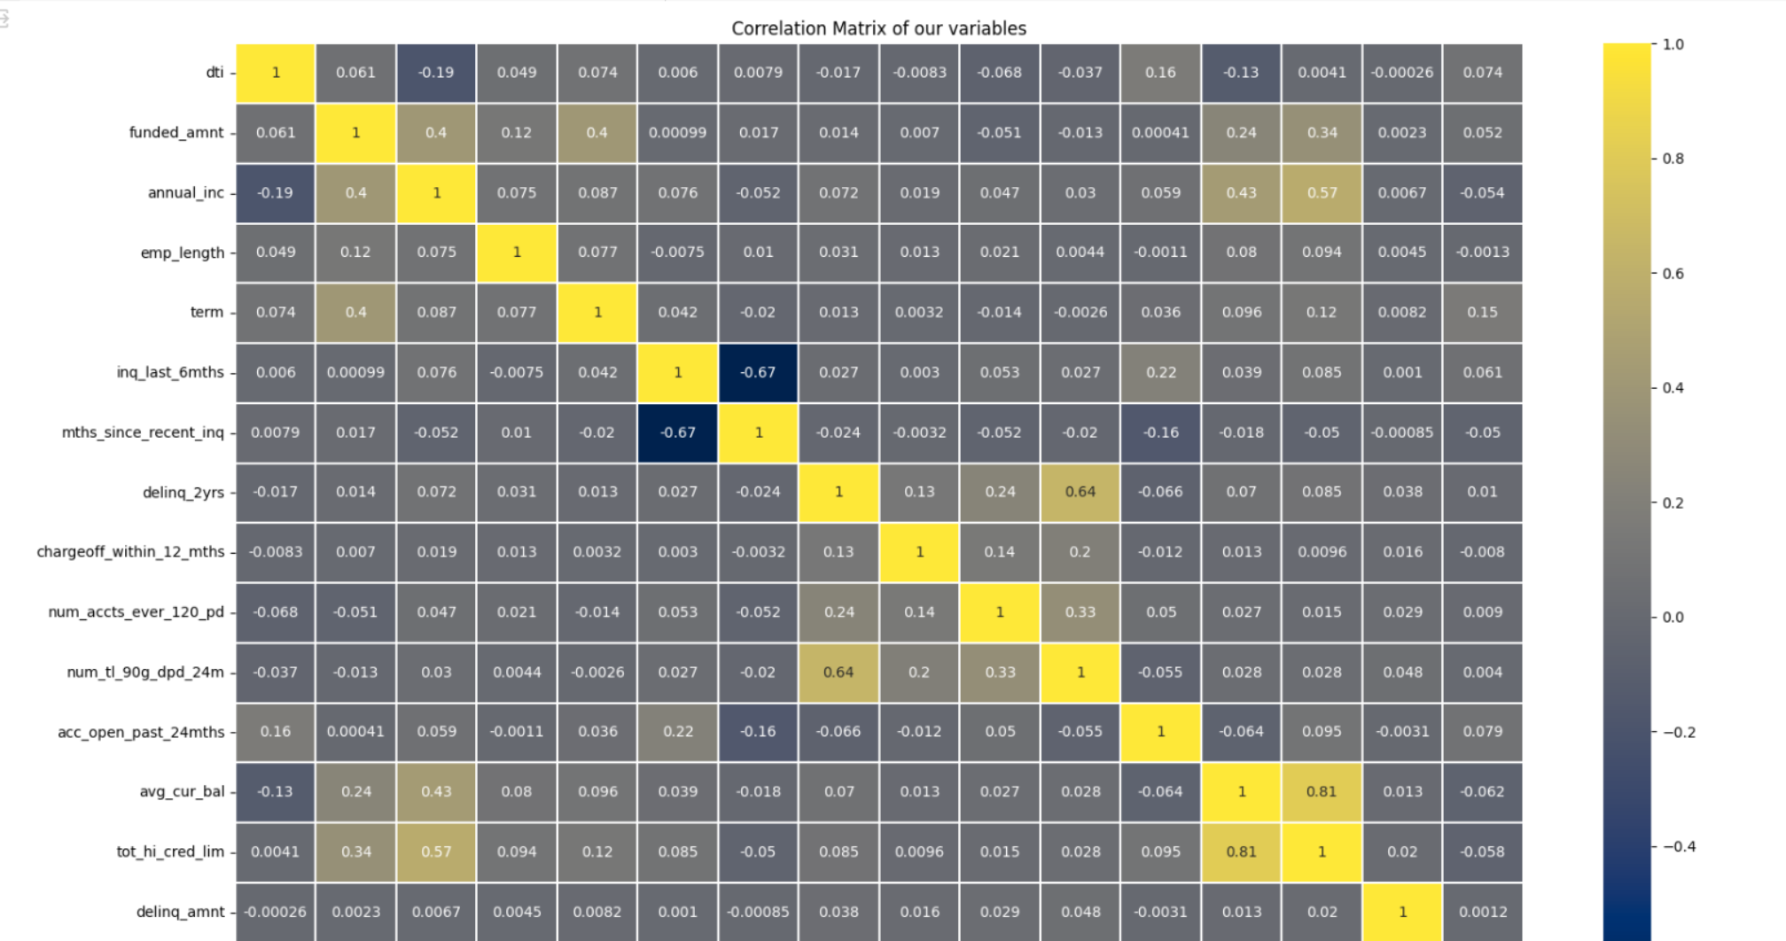
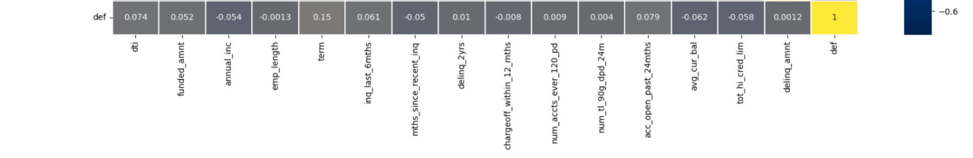
Credit Risk Project
Intro
Correlation Matrix

Slide 7
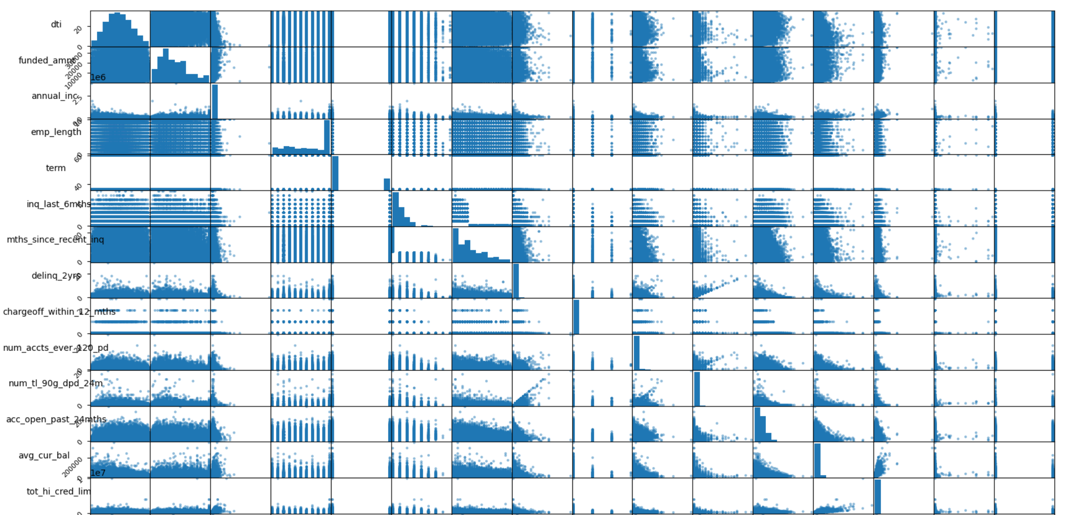
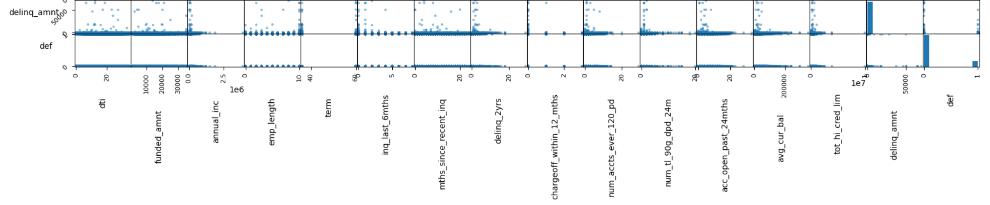
Credit Risk Project
Intro
Correlation Matrix

Slide 8
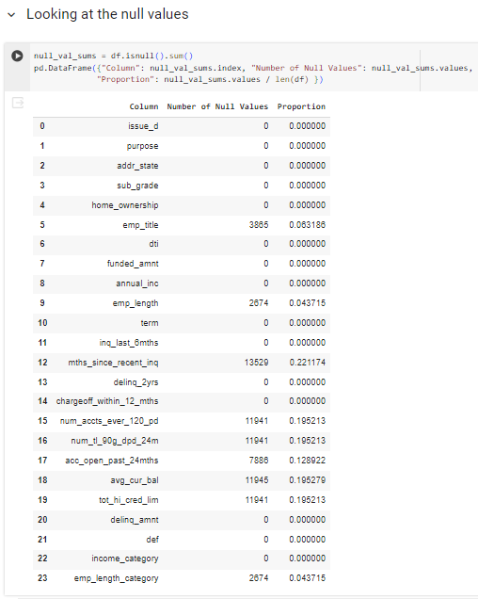
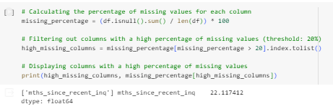
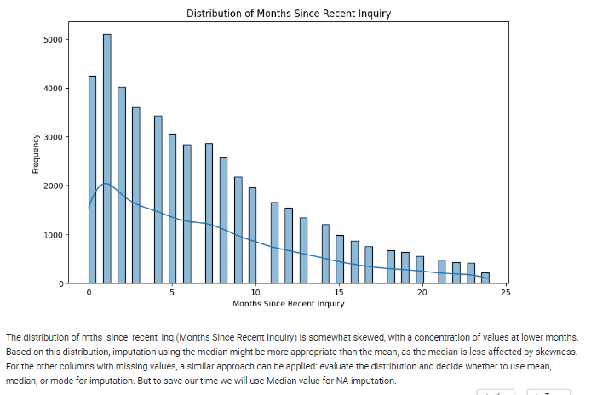
Credit Risk Project
Intro
Null Values

Slide 9
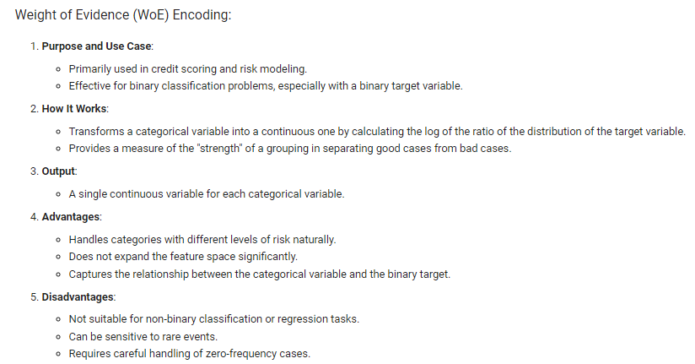

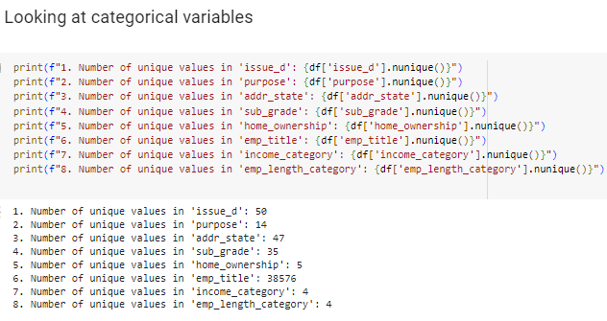
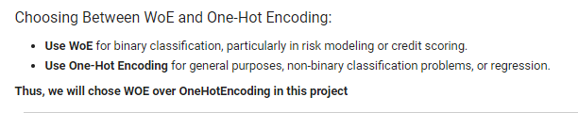
Credit Risk Project
Intro
Categorical Variables

Slide 10
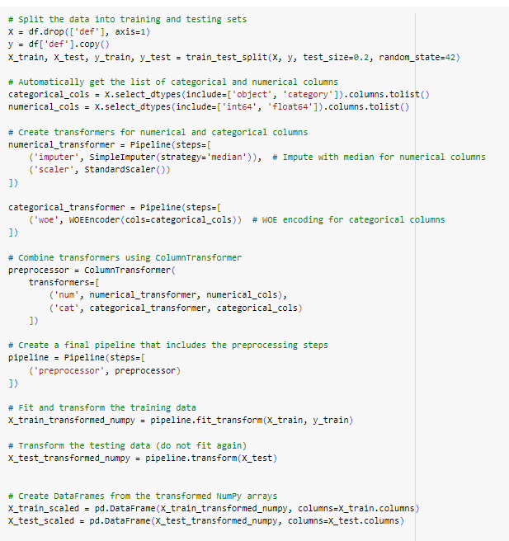
Credit Risk Project
Preparing the Data for the Machine Learning Algorithms
Transformation Pipeline

Slide 11
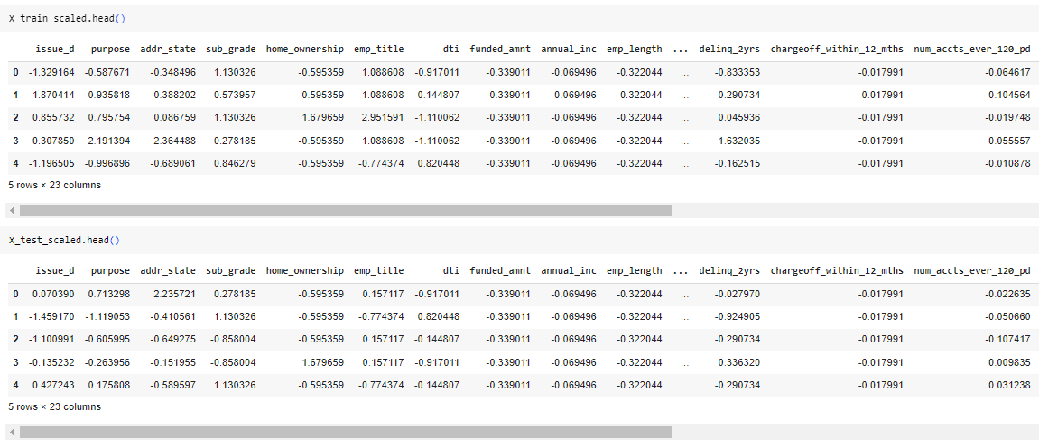
Credit Risk Project
Preparing the Data for the Machine Learning Algorithms
Transformation Pipeline

Slide 12
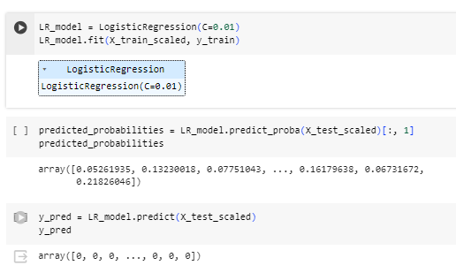
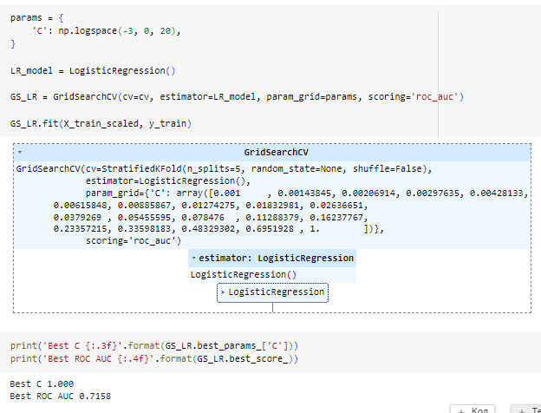
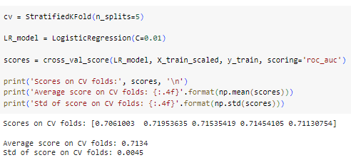
Credit Risk Project
Training Models
Logistic Regression

Slide 13
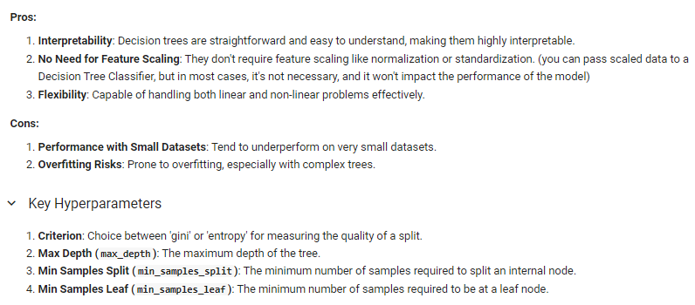
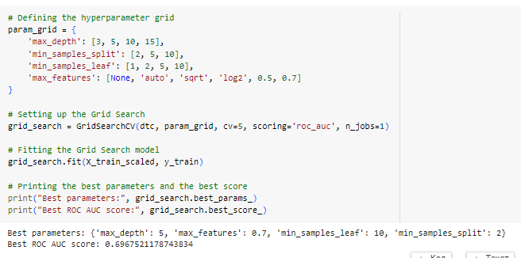
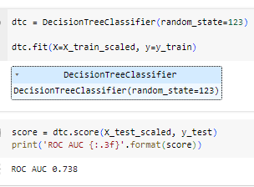
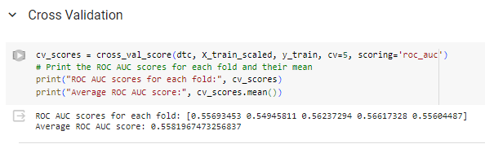
Credit Risk Project
Training Models
Decision Tree Classifier

Slide 14
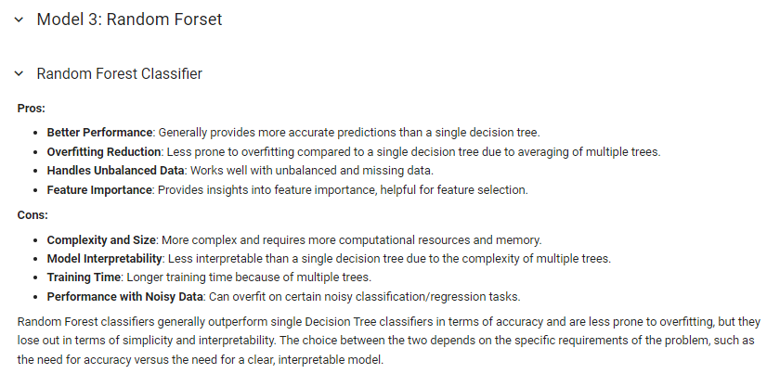
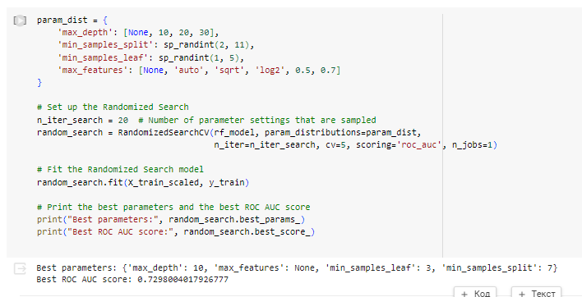
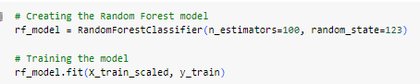
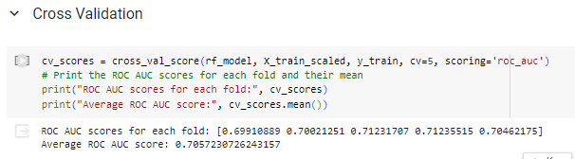
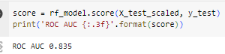
Credit Risk Project
Training Models
Random Forest

Slide 15
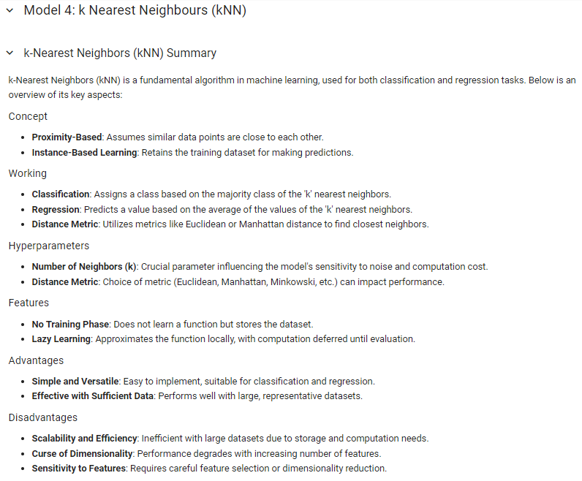
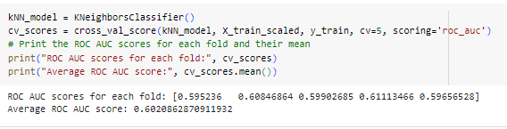
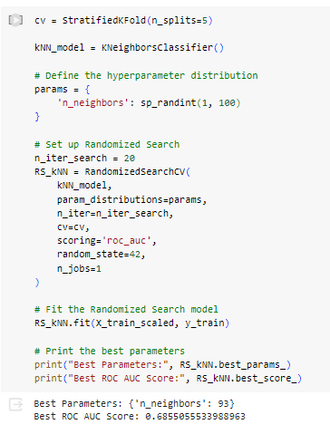
Credit Risk Project
Training Models
k-Nearest Neighbours

Slide 16
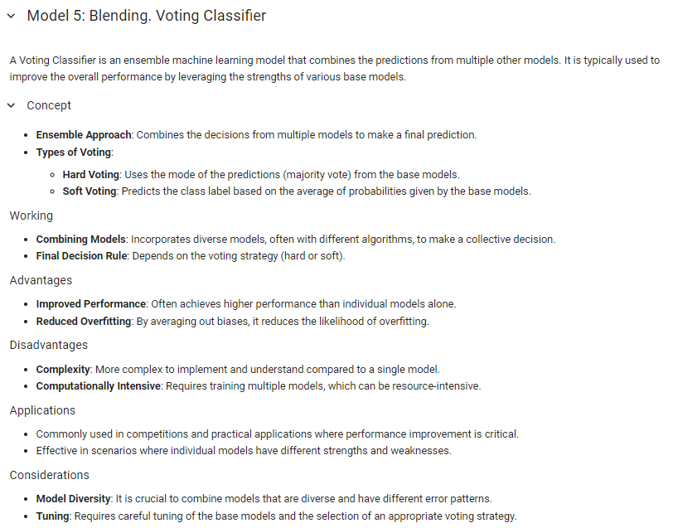
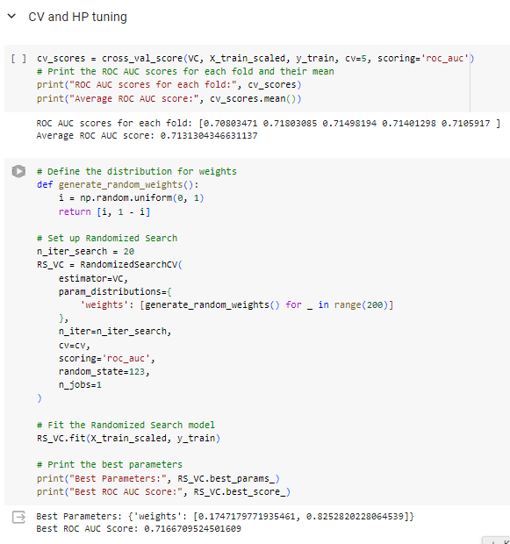
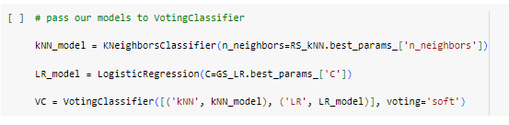
Credit Risk Project
Training Models
Blending. Voting Classifier

Slide 17

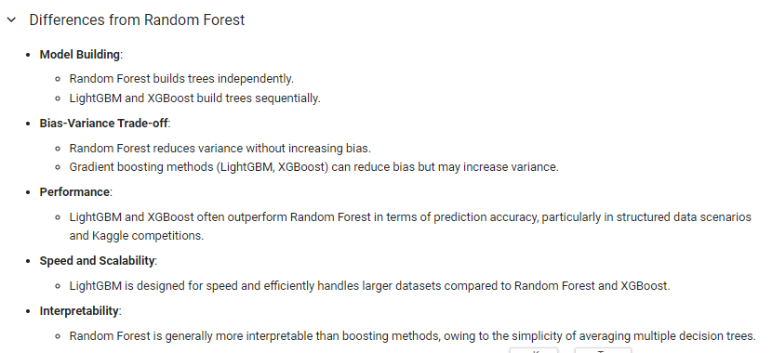
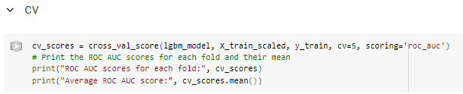
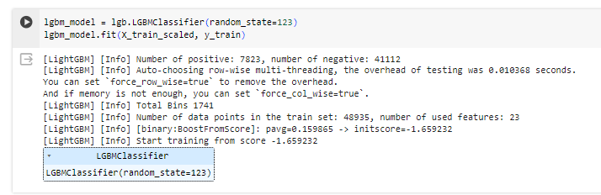
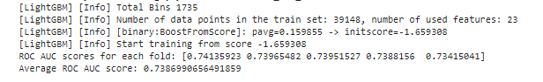
Credit Risk Project
Training Models
LightGBM

Slide 18
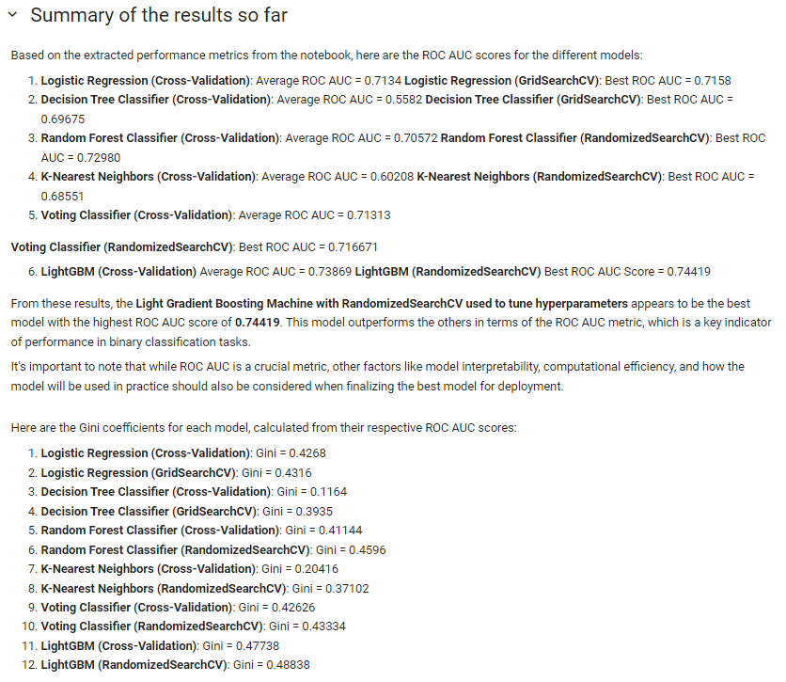
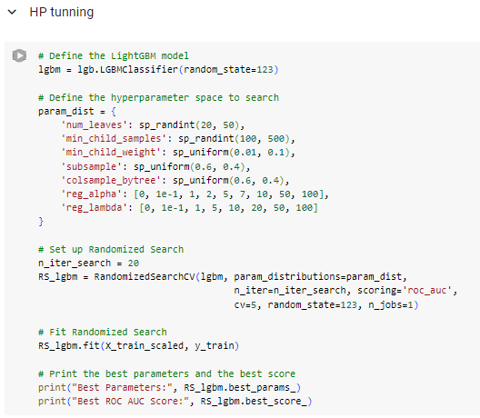
Credit Risk Project
Training Models
LightGBM and Summary

Slide 19
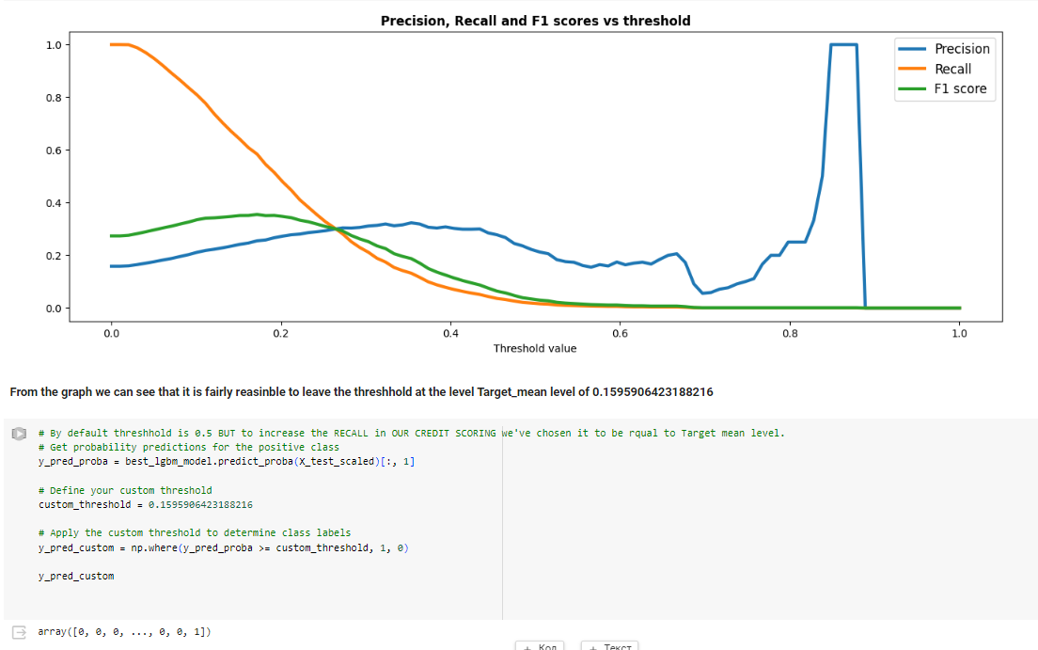
Credit Risk Project
Training Models
LightGBM

Slide 20
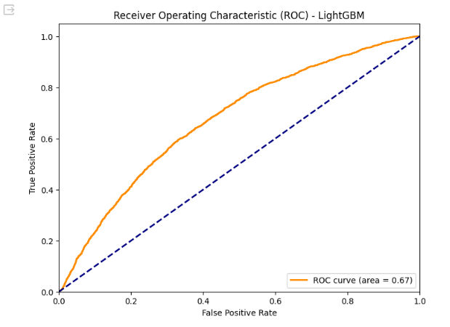
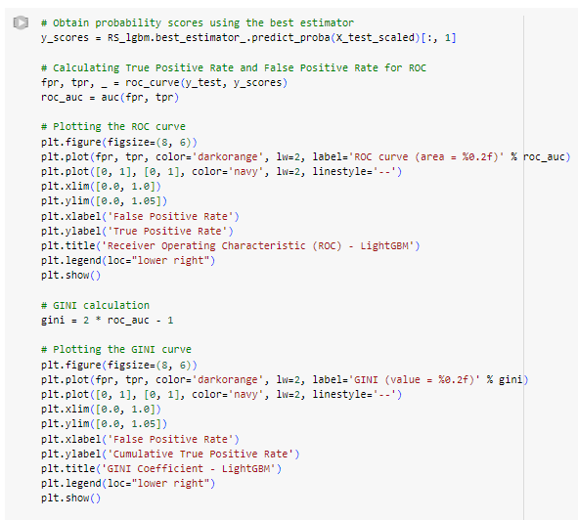
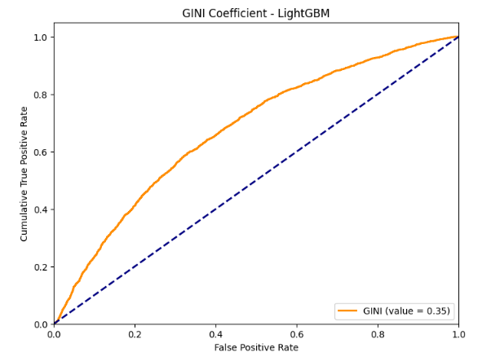
Credit Risk Project
Training Models
LightGBM

Slide 21
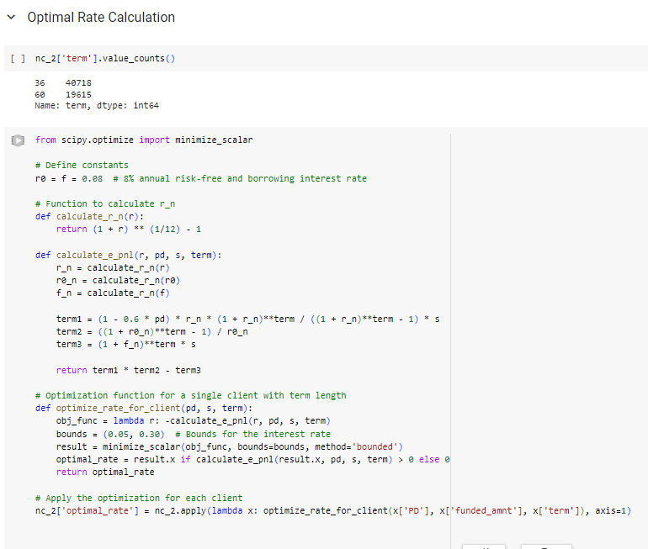
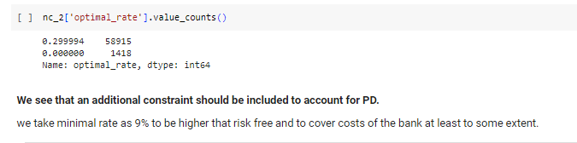
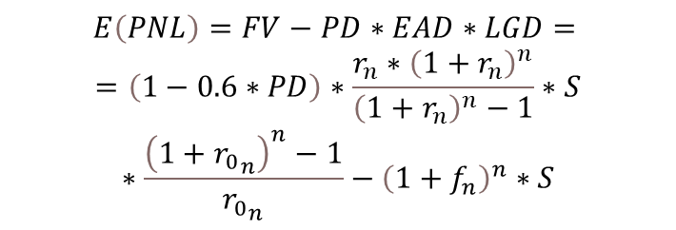
Credit Risk Project
Optimal rate algorithm
$$E\left(PNL\right)=FV−PD∗EAD∗LGD= =\left(1−0.6∗PD\right)∗\frac{r_{n}∗{\left(1+r_{n}\right)}^{n}}{{\left(1+r_{n}\right)}^{n}−1}∗S∗\frac{{\left(1+{r_{0}}_{n}\right)}^{n}−1}{{r_{0}}_{n}}−{\left(1+f_{n}\right)}^{n}∗S$$

Slide 22
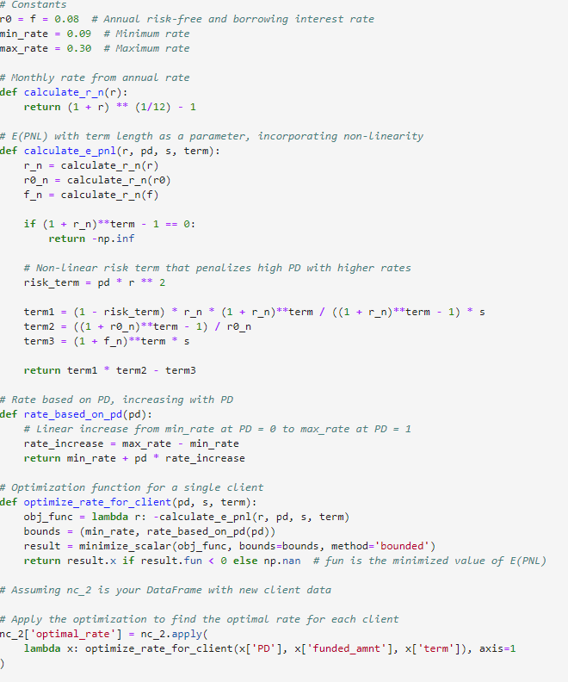

Credit Risk Project
Optimal rate algorithm
Optimization procedure was created with the following constraints:
Maximum and minimum rates of 9% and 30% (the latter one was achieved during first stage of optimization on the previous slide) respectively to avoid potential losses and excessively high rates;
Non – linear risk term structure, penalizing clients with high default rate by higher optimal rates в
To conclude, such algorithm allows to calculate optimal rate (for banks) for each client, given their characteristics
$$E\left(PNL\right)=FV−PD∗EAD∗LGD= =\left(1−0.6∗PD\right)∗\frac{r_{n}∗{\left(1+r_{n}\right)}^{n}}{{\left(1+r_{n}\right)}^{n}−1}∗S∗\frac{{\left(1+{r_{0}}_{n}\right)}^{n}−1}{{r_{0}}_{n}}−{\left(1+f_{n}\right)}^{n}∗S$$
$$r_{n}=\sqrt[12]{1+r}−1$$

Slide 23

Credit Risk Project
Results

Slide 24


Credit Risk Project
Results
The proposed algorithm does not reject anyone, but assigns greater optimal rates for more risky clients

Slide 25


